Slide 1
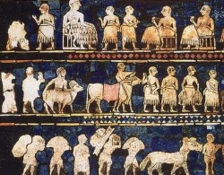
Rise of Sumer
Unit 2- Lesson 1B

Slide 2
Sumer
Notes:
Located in Southern Mesopotamia – Think of Sumer as a region and within this region were a bunch of city-states and they all were located in the area of Mespotamia

Slide 3
Fertile Crescent

Slide 4
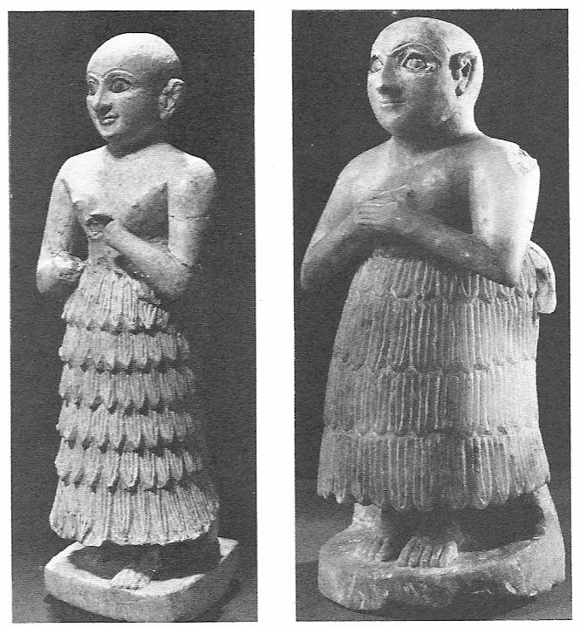
Sumerians
The worlds first civilization
3000 B.C.E
100,000 people
Notes:
Not sure how or when they developed, they just sort of showed up

Slide 5
Development of City-States
Notes:
Consists of a central city and all the countryside around it. One of the most important aspects of Sumerian civilization is the creation of the city- state. So within this region of Sumeria, city-states formed There was a central city hub in the middle and then farming all around it. City states began fighting each other for farmland so sumerian city states had to build up there armies and build up fortification walls

Slide 6
Let’s discuss…
What do you think were the benefits of creating these city-states?

Slide 7
City-States
Independent from one another
Temple in the middle (dedicated to the god or goddess specific to that city-state)
Governed by a priest king
Read “Mesopotamian Government”
Answer questions- discuss

Slide 8
Bellwork- Mesopotamian Government
Get your Mesopotamian Government questions out so we can discuss them (what you did on Friday).

Slide 9
9th Period Bellwork:
Get ready to answer these questions
What was a city-state?
Who governed city-states?
Who was the worlds 1st civilization?

Slide 10
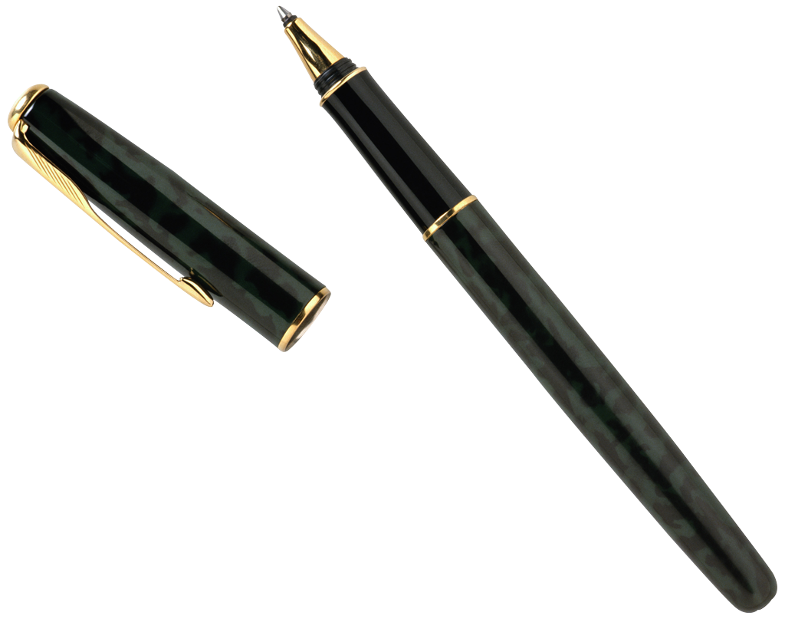
City-States
People owned their own land
Ruling class had large estates
laborers in lower classes
Taxes were collected
Scribes kept records

Slide 11
Sports and Recreation
I have no idea what’s going on
Come at me, bro!
Boxing and wrestling were popular sports
Would ride on each others shoulders and hit a ball with a large stick
Winners could take the women of the losers
Board games have been found in ancient ruins
Sling shots, bow and arrows, boomerangs, and jump ropes

Slide 12
Warfare
Sumerian language
Always battling each other
Control over water supplies and fertile land
Built bigger walls for protection
Notes:
Langauage was the only thing they shared
This land was only so big, each city state was in sight of each other, what happens when you are that close to someone with limited resources?

Slide 13
Sumerian City-States
Kish
3100 B.C.E
Ruled by Kings
Unique because this
city-state was once
rule by a woman.

Slide 14
Sumerian City-States
Ur
Right on the coast near the mouth of the Euphrates.
3800 B.C.E
Ruins from this city still stand today
One of the most wealthy city-states
Code of laws- “Code of Ur-Nammu”

Slide 15
Ur Ruins

Slide 16
Sumerian City-States
Uruk
50,000-80,000 residents (largest city in the world 2900 B.C.E)
King Gilgamesh
Read “The Legendary Gilgamesh” article as a class
Watch: Epic of Gilgamesh
Notes:
HE was a semi-mythic King He probably did exist but his influence was so profound that myths developed about him-- Written on 11 tablets-an epic poem is a long narrative story about heroic deeds and events that are significant to the culture of the poet. Many ancient writers used epic poetry to tell tales of intense adventures and feats.

Slide 17
Exit Ticket
In your Journal- reflect on the Epic of Gilgamesh. Why do YOU think Epic Poems exist? What was the moral of the epic? What did you like most about this story?

Slide 18
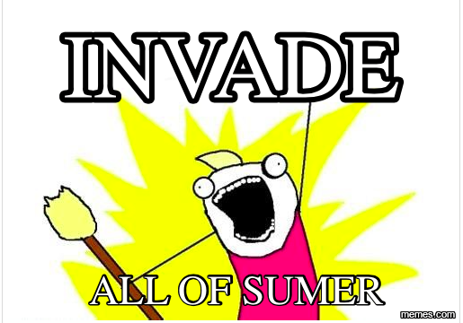
Bellwork
Edmodo “Bellwork for Wednesday, September 7”
Notes:
Have P9 finish the video/write their responses 1st

Slide 19
Remember…
Mesopotamia was what the land was called
Sumer was the region
Then there were multiple city-states within the region of Sumer
This area was the first civilization, the “Cradle of Civilization” because it was the first permanent settlement of people in history.

Slide 20
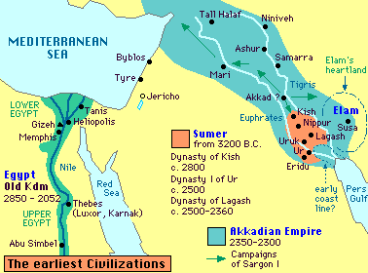
The Great Akkadian Empire
Mark this on your map with a series of /// throughout the area
2350-2200 B.C.E
Threatened the Sumerians
Notes:
So today we are going to talk about the expansion and growth of these ancient civilizations, and one in particular: Akkadian
Lived north of Sumer--Important to know that they were not part of Sumerian society -- At first they lived in Peace with those around them
Starting around 2300 B.C.E that all changed because of one man

Slide 21
Emperor Sargon
Extended Akkadian territory into an empire
Empire- land with different territories and peoples under a single rule
Built new capital: Akad on Euphrates
Defeated all the city states of Sumer & most of the fertile crescent.
Worlds 1st emperor
His reign stretched from the Persian Gulf to the Mediterranean Sea

Slide 22
“[Sargon] had neither rival nor equal. His splendor, over the lands it diffused. He crossed the sea in the east. In the eleventh year he conquered the western land to its farthest point. He brought it under one authority. He set up his statues there and ferried the west's booty across on barges. He stationed his court officials at intervals of five double hours and ruled in unity the tribes of the lands. He marched to Kazallu and turned Kazallu into a ruin heap, so that there was not even a perch for a bird left.”
Notes:
A Babylonian text stated this about him

Slide 23
Sargon Social Media Assignment

Slide 24
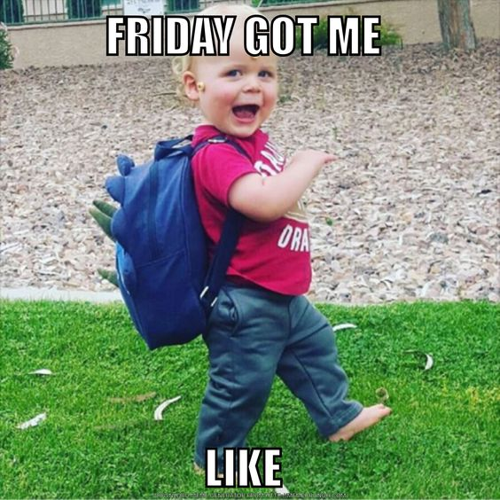
Bellwork
Download Mesopotamian Gods/Goddess info sheet on Edmodo and put it in Notability!
Notes:
monday

Slide 25
Sumerian Religion
Notes:
Religion was the basis for all of Sumerian society- played a role in every aspect of life.

Slide 26
Vocabulary
Polytheism- the worship of many gods
Priests- people who performed or led religious ceremonies
Social hierarchy- the division of society by rank or class
Notes:
Priests had great status in Sumer. People relied on them to help gain the gods’ favor. Priests interpreted the wishes of the gods and made offerings to them. These offerings were made in temples, special buildings where priests performed their religious ceremonies

Slide 27
Sumerian Religion
Polytheistic
Major role in everyday life
Believed gods had enormous powers
Success in life depended on pleasing the gods
Notes:
The worship of many gods

Slide 28
Heaven/Underworld
Ekur
Assembly of the gods (think of Mount Olympus in Greek mythology)
Was the most admired and sacred building of ancient Sumer
Kur
The underworld (home of the dead)
Think of Hades in Greek mythology
Notes:
Believed this is where the gods lived

Slide 29
Sumerian gods Scavenger Hunt
Posted around the room are pictures and information about some of the Sumerian gods. Please fill out the information sheet as you explore each god/goddess around the room!!
Notes:
end of day-(Tuesday)
Bellwork for Wednesday: What is polytheism? What powers did Sumerians believe their gods possessed? Why did priests have high status’ in Sumer? What conclusions can you draw about the importance of religion to ancient Sumerians based on yesterdays lesson?

Slide 30
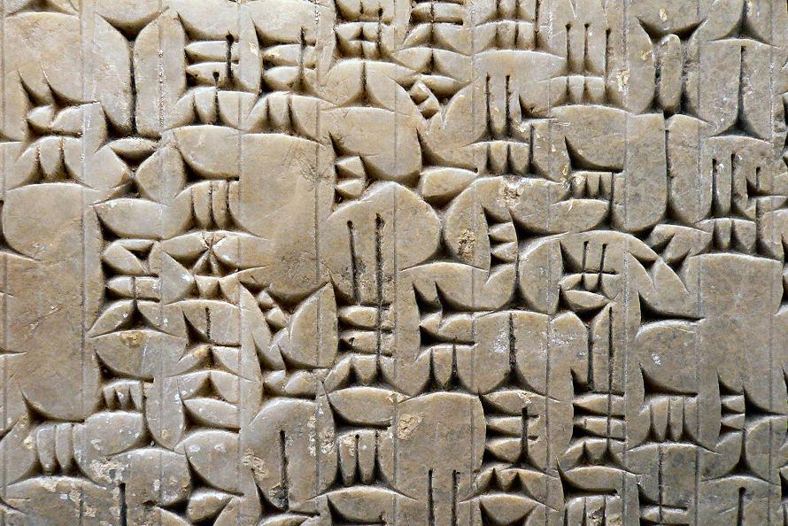
Invention of Writing
Cuneiform
the words first system of writing
used sharp tools they called styluses
wedge shaped symbols on clay tablets
Notes:
They did not have pens, pencils, and paper

Slide 31
Evolution of Writing
Pictographs
Early written communication used picture symbols
Sumerians first used cuneiform to keep business records
scribes would keep track of items that were traded
Schools
students went to school to learn to read and write
Notes:
Read a story about a Sumerian boy who did not want to go to school and how much it upset his father that they had to have a fight everyday before school

Slide 32
Writing
History, law, grammar, and math
Works of literature
What have we already looked at that was an early work of literature?

Slide 33
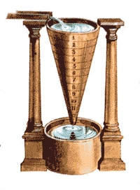
Advancements and Inventions
The wheel
wheeled vehicles like the cart/chariot
Plow
Clock
used falling water to tell time
Notes:
Plow was pulled by oxen, plows broke through the hard clay soil of Sumer to prepare it for planting. Increased farm production
Clock- water would go into the the funnel and drip out into a container, people would measure how much time had passed based on how much water had dripped out

Slide 34
Math and Science
Circle- 360 degrees
Dividing a year into 12 months
The importance of the number 60
60 minutes=1 hour
Area of rectangles and triangles
Studied animals, plants, and minerals and wrote down what they studied
Advancements in medicine
used plants and herbs for healing

Slide 35
Checkpoint Answer the following on a piece of paper
Think/Pair/Share
What was one of the most important technical development of Sumer?
What Sumerian achievement in math do we use every day when we look at a clock?
What invention or advancement of the Sumerians do you think was the most important? Why?

Slide 36
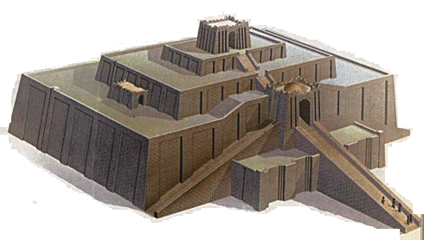
The Arts of Sumer
Architecture
the science of building
ziggurat- a pyramid shaped temple
Notes:
Sumerian rulers lived in great palaces, other rich Sumerians lived in two story homes with many rooms, most Sumerians lived in one story small homes – bricks made of mud were the buildings main building block

Slide 37
You do it!

Slide 38
Babylonians, Assyrians, and the Phoenicians
The later civilizations of the Fertile Crescent

Slide 39
Map It
Babylon

Slide 40
Map-It Practice (15-20 minutes)

Slide 41
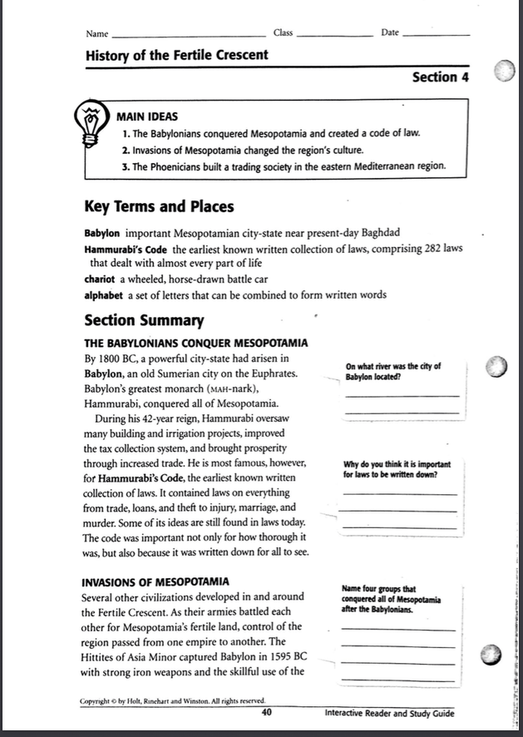
Close Reading
Mark up the text
Answer the questions
“Other People of the Fertile Crescent” on Edmodo

Slide 42
Hammurabi’s Code of Laws
The earliest known written collection of laws
282 laws
Important
very thorough
written down for all to see
we still use some of these ideas today
Lets read some!
Answer questions

Slide 43
Hamurabi’s Code Questions
Answer on a sheet of paper and turn in
Were the laws fair or unfair, or both? Give examples.
Were the laws appropriate for the time period? Explain.
Who did the laws favor and who was not favored? Explain
Have society’s problems changed or remained the same? Explain.

Slide 44
End of Mesopotamia
Invasions
intermarried with other people
became part of their culture (Babylonia)
Babylonian culture prevailed
had elements of Sumerian culture
Attacked by Greeks and Romans

