Slide 1
Bellwork- Download files for today
Download all files into Notability. This needs to happen. I am no longer responsible if you do not do this. We have gone over it 1,000,000 times!
“What makes a civilization” reading
“What makes a civilization” questions
“Day to day "reading
“Fertile Crescent/Mesopotamia Map
Unit 2-Lesson 1 PowerPoint

Slide 2
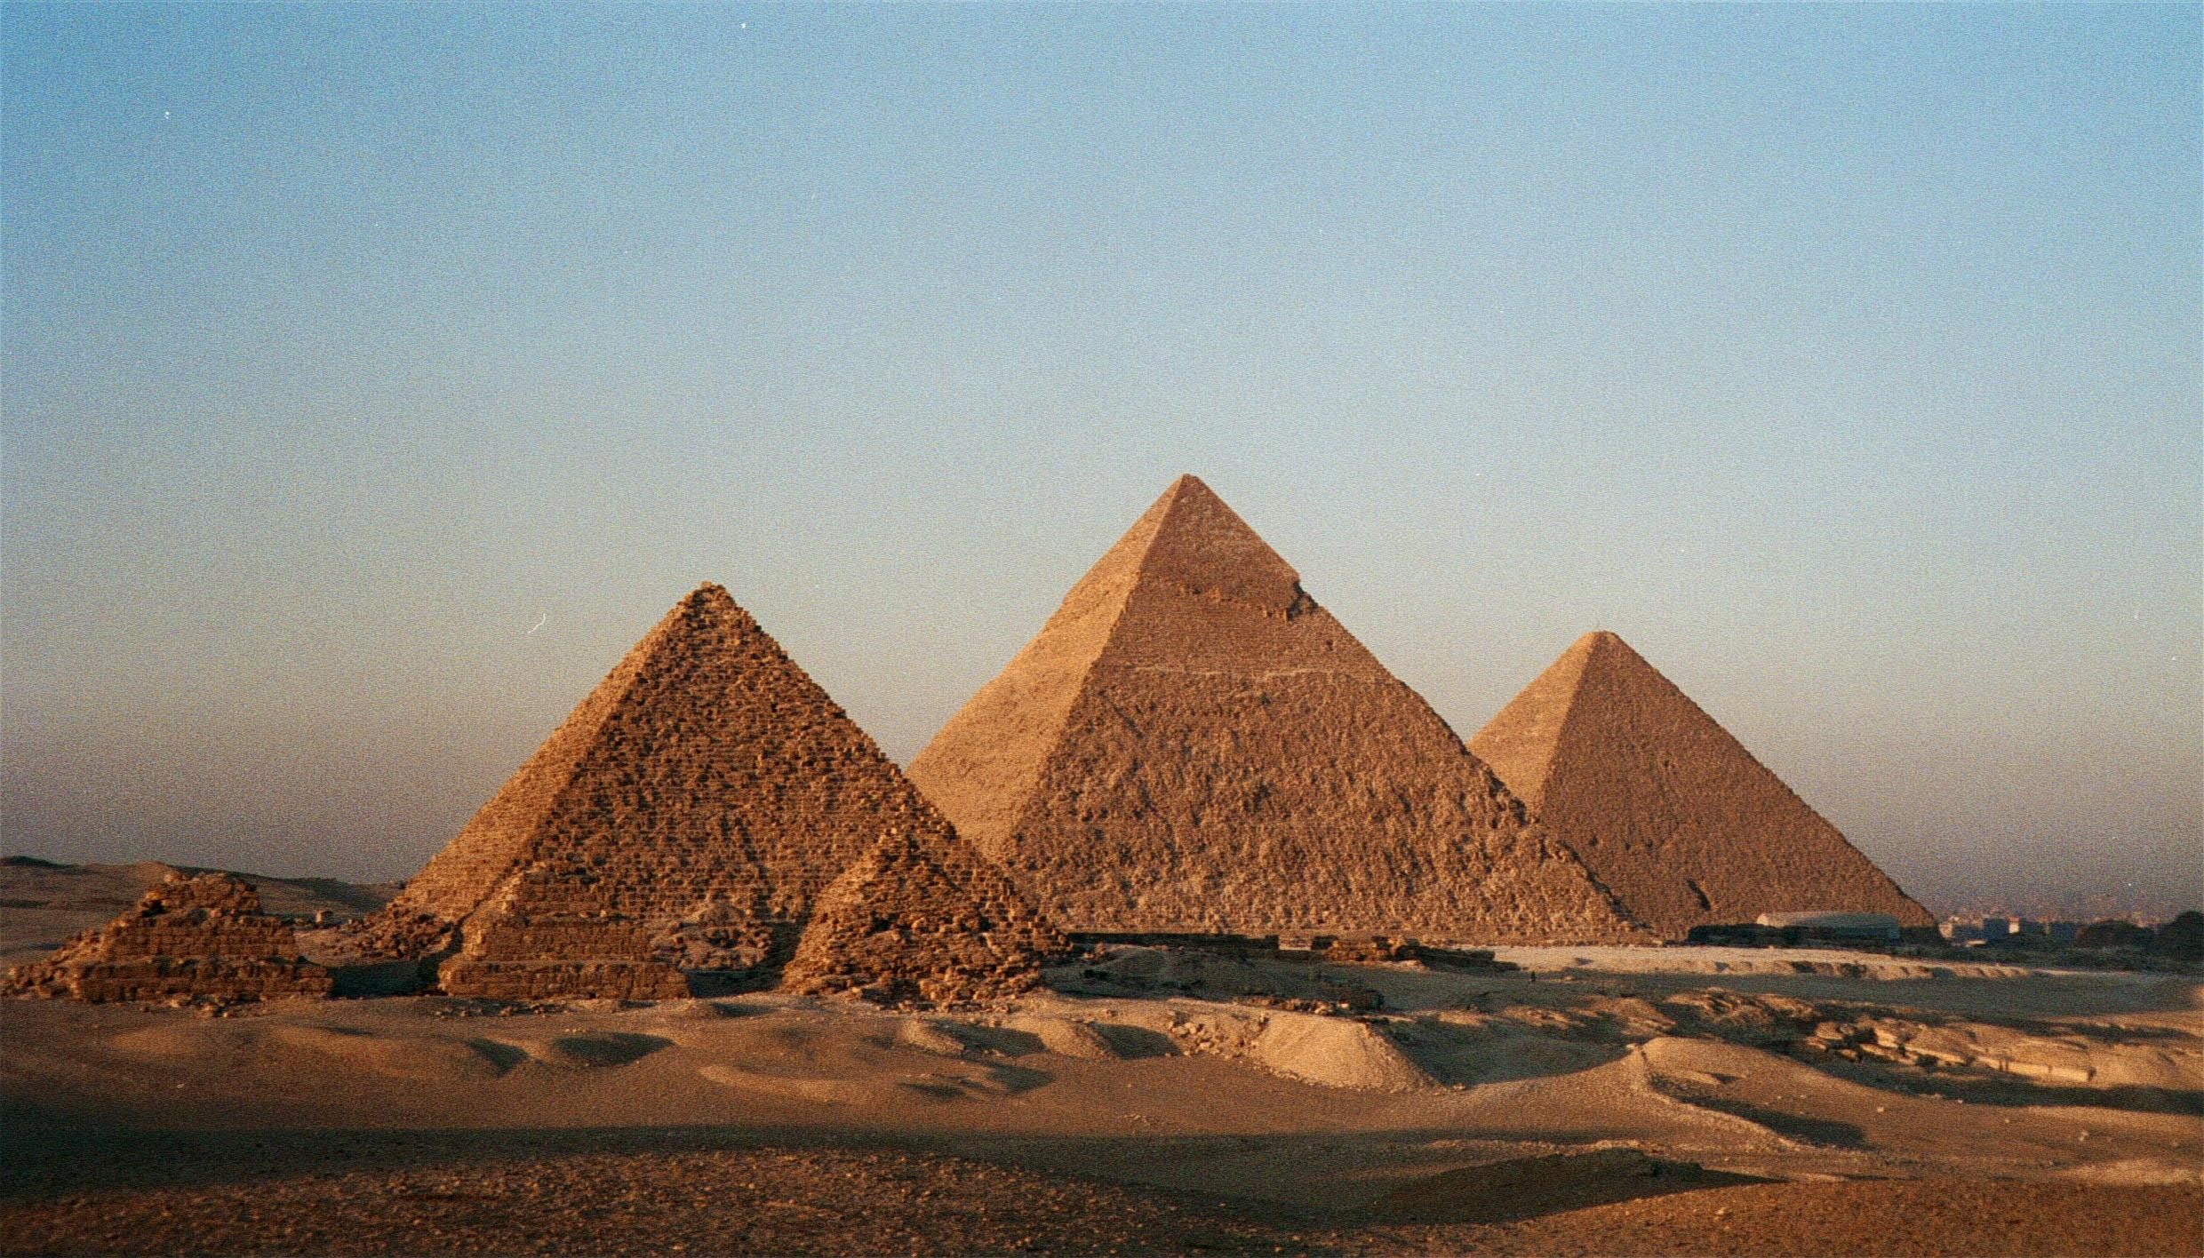
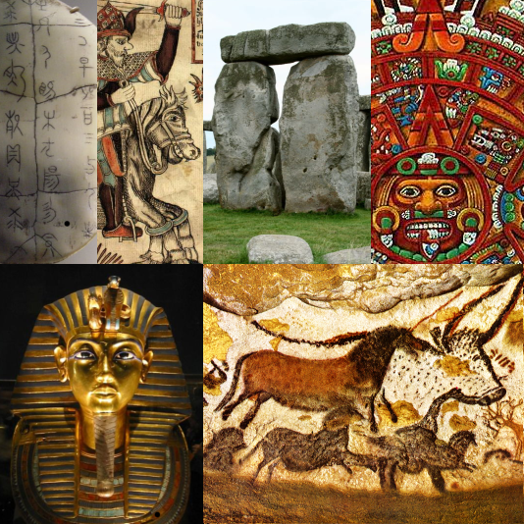
Unit 2: Ancient Civilizations
Lesson 1: Intro to Mesopotamia

Slide 3
Vocab List
Since it was such a difficult task this past unit, I will not be providing you with a Vocab List. I still have all vocab words in red. If you want EXTRA CREDIT POINTS at the end of this unit you can turn in your own vocab list!

Slide 4
What is an ancient civilization?
Read “What Makes a Civilization”
Mark Up The Text (MUTT)
Answer Questions

Slide 5
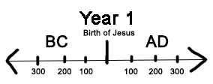
Terms to Know…
Numbering calendar years:
B.C. or B.C.E: Before Christ or Before Common Era
A.D or C.E: Anno Domini or Common Era
Dynasty-sequence of rulers
Notes:
Referring to the year Jesus Christ was born in the Christian relgion

Slide 6
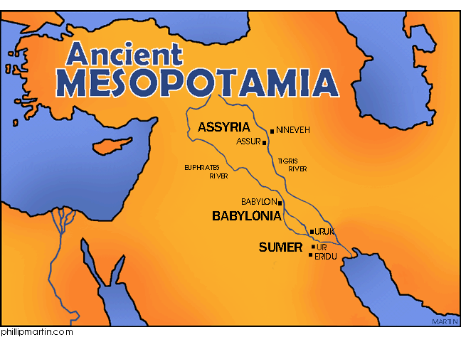
Fertile Crescent
Area between the Tigris and Euphrates River
Became known as Mesopotamia which means “Between two Rivers”
Notes:
We are first going to look at the area known as the Fertile Crescent ,present day middle east( Syria, Jordan, Lebanon. Isreal)- Around 7000 BCE

Slide 7
Download Map
Notes:
Red-Fertile Crescent

Slide 8
Fertile Cresent
“Cradle of Civilization”
Flow of water
silt: a mixture of rich soil and tiny rocks
Abundant Clay
3 dominant civilizations in this area
The Sumerians and Akkadians (3500-2006 B.C.E)
The Babylonians (1792-539 B.C.E)
The Assyrians (115-612 B.C.E)
Notes:
First civiliations called mespotamians

Slide 9
Mesopotamians
How did these civilizations thrive?
Water control
Irrigation and Canals
Irrigation: a way of supplying water to an area of land
Canals: human made waterways
Food surplus
Occupations developed
Trade

Slide 10
Day to Day
Read “Day to Day” article to get a better understanding of these early civilizations
Discussion:
So what was it like? Using information from the article lets have a discussion about the day to day life of these early people.

