Slide 1

Ancient Egypt
unit 2
Introduction

Slide 2
What do you know?
K-W-L Chart
Notes:
Write on board

Slide 3
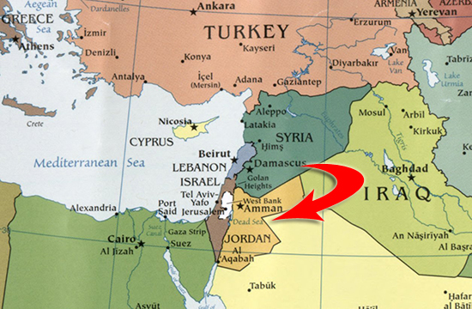
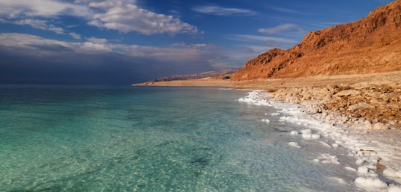
geography of Egypt
Dead Sea-Why is it called this?
Notes:
Called this because no plats or anmimals can survive the salty water! 10 times saltier than oceans – located in Israel right next door to Egypt. Ancient Egyptians used the salty water to help mummification

Slide 4
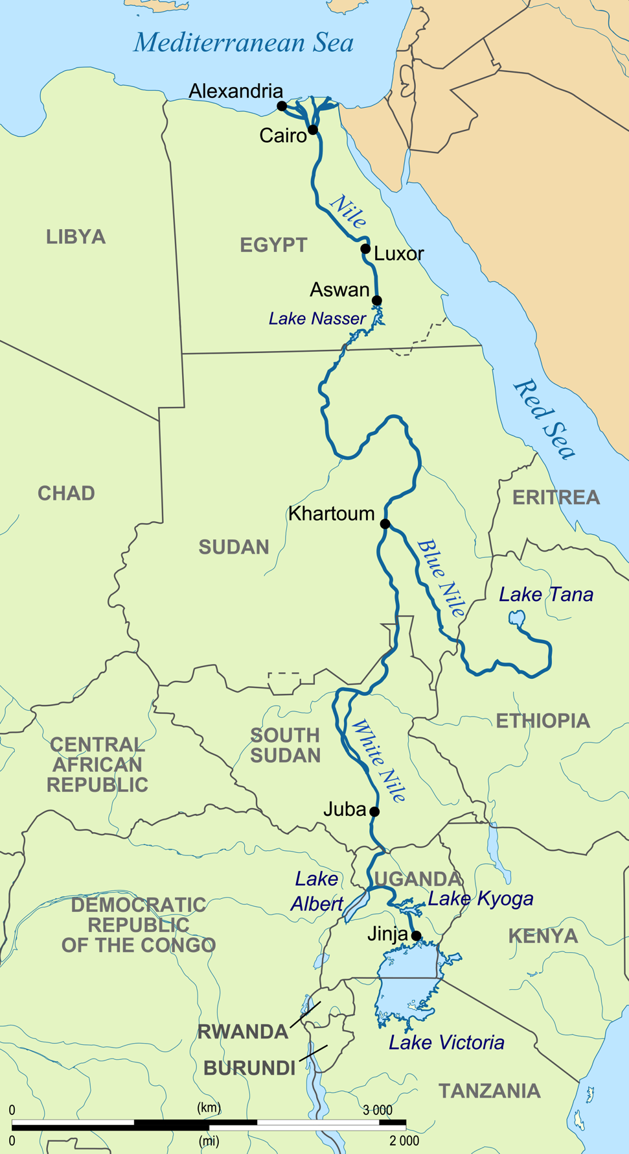
Geography of Egypt
Nile River
  “The Gift of the Nile”
  Longest river in the world
Notes:
Called the gift of the Nile because it’s in the middle of the desert

Slide 5
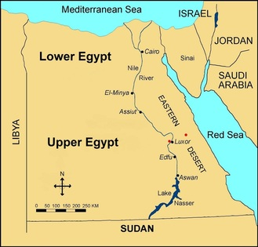
Geography of Egypt
Southern Region
Northern Region
Called Upper Egypt because it was located up river from the Niles flow
    Called Lower Egypt because it was down river to the Niles flow
Notes:
These acted as two separate kingdoms for a very long time- people of Lower Egypt and people of Upper Egypt

Slide 6
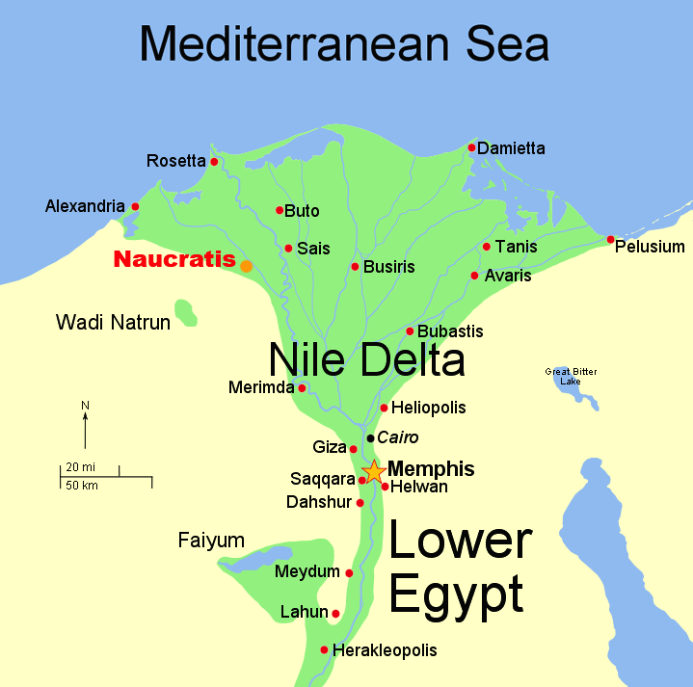
Geography of Egypt
Fertile River Valley
Nile Delta
  2/3 of Ancient Egypt's farmland
  River delta: an area of low land where a river spreads into many smaller rivers near the sea.
  Silt: sand, mud, soil etc. that is carried in water and then settles on the land
Notes:
Located in a very fertile area called the Nile Delta

Slide 7
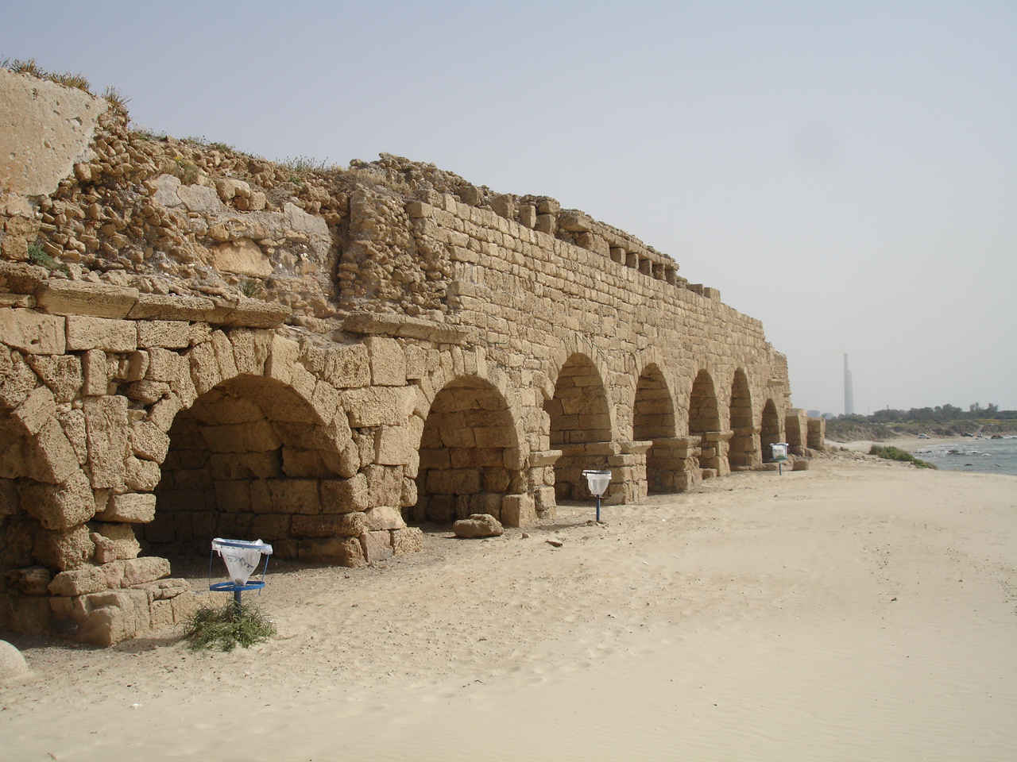
geography of Egypt
What doesn’t happen much in deserts?
Aqueducts
  track the annual flooding
Natural boarders created safety
  deserts, bodies of water, cataracts in the Nile

Slide 8
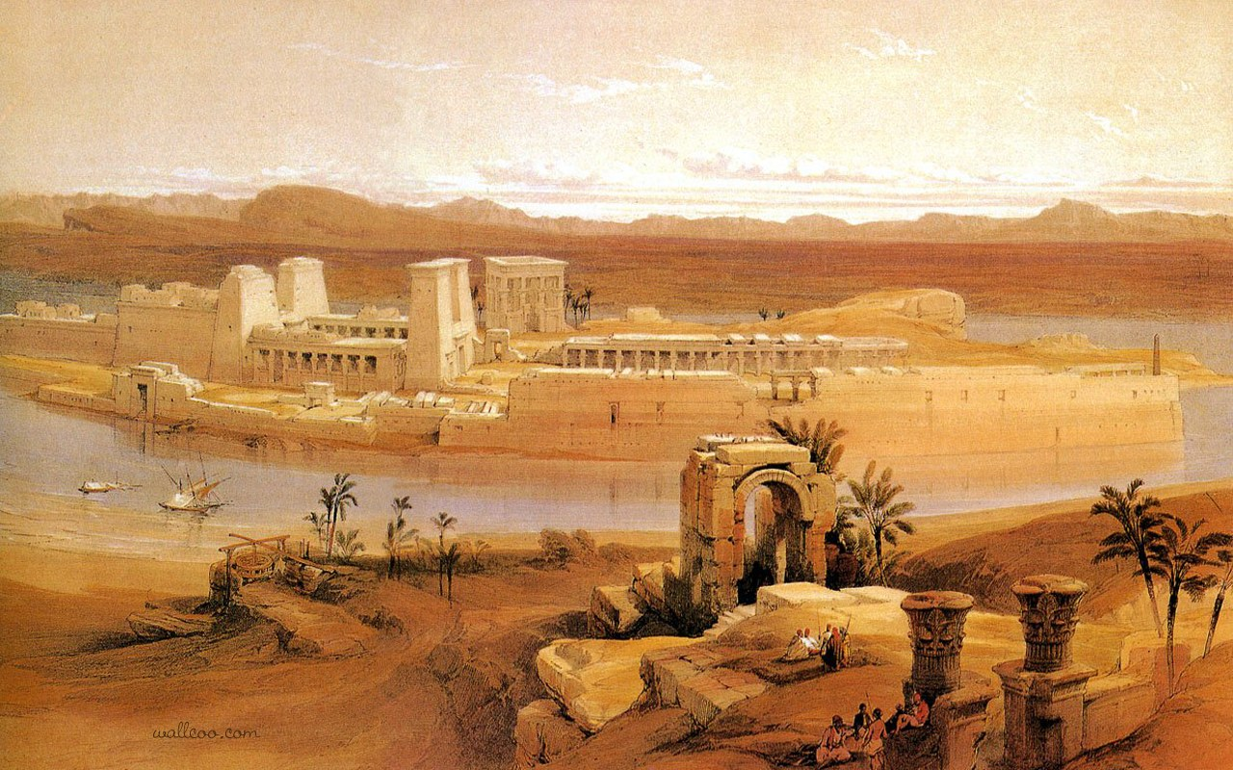
Civilization develops
Very similar to Mesopotamia
Irrigation Systems
Wheat, barely, fruits and vegetables
Raised cattle and sheep
River provided food
Notes:
Hey were out in the middle of no where but things are growing here!

Slide 9
What helped ancient Egypt grow?
Now I want you to fill out the “L” portion of your chart with what you learned today. Turn this in to Edmodo.
  Natural barriers
  How did the Nile provide life to these people?
  Upper/Lower Egypt
Notes:
Assessment/End of Day 1

