Slide 1
Bellwork : Look at this picture, describe what you see or what you think is happening here (in your journal)
Notes:
Great departure

Slide 2
Buddhism
Unit 3
Lesson 5

Slide 3
Vocabulary Quick Search
When I say go, you are going to get up and find someone you are NOT sitting by and discuss what you think these four vocabulary words mean. Then, as a duo figure out the actual meaning and write it down. We will then come back together as a class to discuss what you found.
Meditation
Fasting
Nirvana (not the band)
Missionaries
Notes:
Have students look up these vocabulary words – grab a text book go to page 484 or the glossary

Slide 4
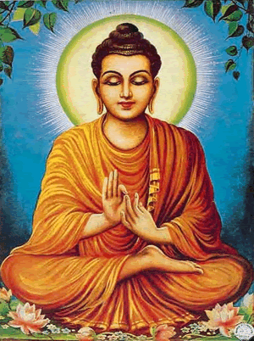
What is Buddhism?
Not a religion, but a way of life.
There is no higher power that anyone worships
Philosophy – a theory or guiding principal in someone’s life

Slide 5
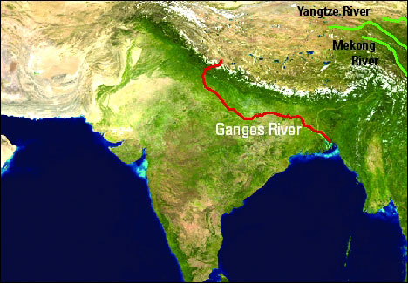
Origins
Began in India
Ganges River Valley
North East India

Slide 6
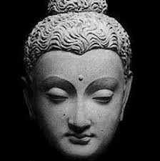
Origins
Siddhartha Gautama
Born 563 BCE
Prince
Hindu
Inner struggle
“Why do people struggle”
The Great Departure

Slide 7
Quest for Answers
Great journey
Free his mind from daily concerns
fasting
meditation
Finally ended his journey in Gaya, close to the Ganges River.
Notes:
He talked to Brahmins and priests and kings

Slide 8
Gaya, India
Notes:
94 foot tall statue – significant because Buddhist believe this is where Buddha gained enlightenment – can we compare this to anything in the other religions we have studied?

Slide 9
Buddha finds his answers
7 weeks of deep mediation
Human suffering comes from wanting things you don’t have, being afraid of losing what you have, and not wanting something you have.

Slide 10
Enlightenment
Enlightenment
sudden realization of the truth and knowledge
The Buddha
“The enlightened one”
Spread his teachings

Slide 11
Checkpoint (Think-pair-share)
Who was Siddhartha Gautama?
What did Siddhartha endure (go through) before reaching enlightenment
Of the three things that Siddhartha said caused human suffering, which one do you think causes the most suffering today? Why?
Notes:
a prince who became known as the Buddha
Wandered for several years, didn’t wash, fasted, mediated

Slide 12
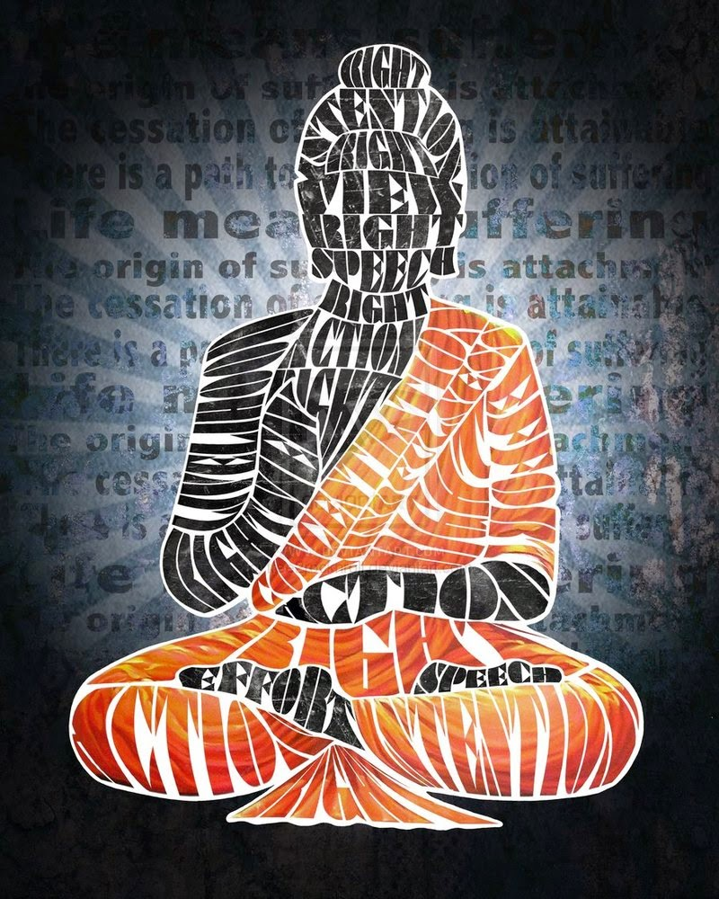
TEACHINGS and beliefs
BUDDHISM:

Slide 13
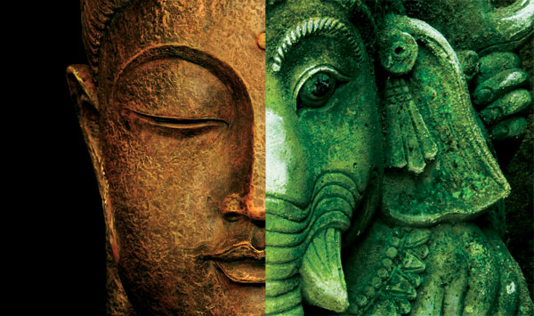
TEACHINGS
Gained followers
kings, merchants, and artisans
became the first followers of the new “religion”
Hindu roots
act morally
treat others well
Notes:
Since he was raised Hindu and many of is teachings reflected Hindu ideas

Slide 14
Eight Fold Path (Guidelines for living)
Right Understanding- seeing the word as it is, not how we want it to look (following the Four Noble Truths)
Right Intent- Incline toward goodness and kindness (free your mind of evil)
Notes:
There are two major guiding principals or system of beliefs for Buddhists.. the first is the eight fold path

Slide 15
Eight Fold Path
3. Right Speech- avoid lies and gossip (avoid anything that hurts others)
4. Right Action- don’t steal from or harm others- make sure your actions don’t cause suffering

Slide 16
Eight Fold Path
5. Right Livelihood- reject working a job that hurts others (respect the people you work with)
6. Right Effort- put effort into what you do

Slide 17
Eight Fold Path
7. Right Concentration- practice proper meditation
8. Right Mindfulness- control your feelings and thoughts- don’t get lost in the past and “what could have been”

Slide 18
FOUR NOBLE TRUTHS (Foundation of Buddhism)
Suffering exists
Suffering happens from attachment to desires
Suffering stops when attachment to desire stops
Freedom from suffering is possible by practicing the Eight Fold Path
Notes:
Four guiding principals/heart of Buddha’s teachings – Foundation of Buddhism – there is a path to liberation from repeated worldly existence More simply put, suffering exists; it has a cause; it has an end; and it has a cause to bring about its end.

Slide 19
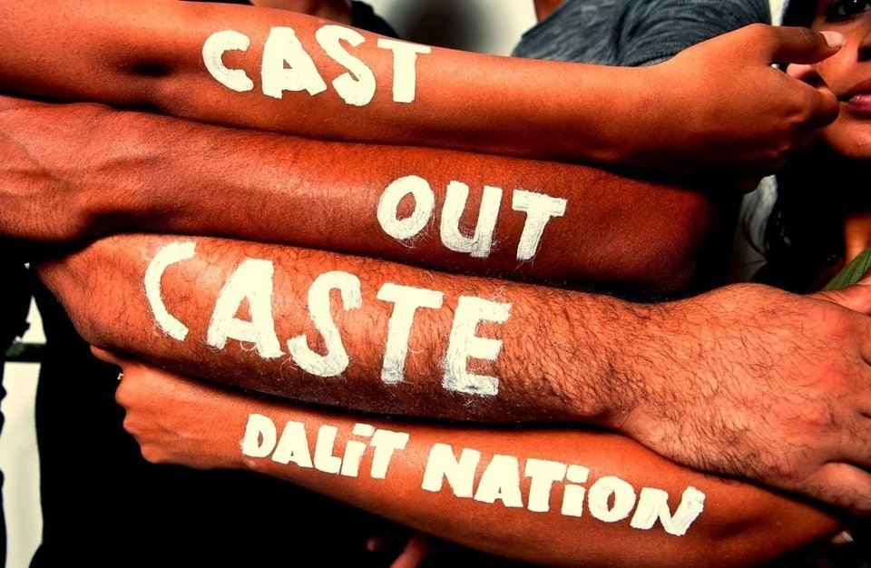
Challenging Hindu ideas
Challenged traditional Hindu ideas
The Vedas
Authority of Brahmins
Caste system
Did believe in the idea of reincarnation
By the time of his death in 483 BCE, the Buddha's influence was spreading rapidly though out India.
Notes:
A lot of what is in the Vedas such as animal sacrifice
challenged the authority of Brahmins- didn’t believe their rituals were necessary for enlightenment. it was each persons responsibility to work for their own salvation- priests couldn’t help
Opposed the caste system- didn’t think people could be confined to a particular place in society. He taught that every person who followed the Eightfold Path properly would reach nirvana- it didn’t matter what varna, caste you were in (this helped win the support of the masses) (had the power to change their own lives)

Slide 20
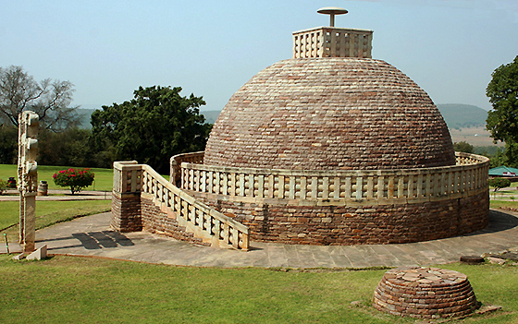
Place of Worship
Not required
Pagodas
Japan and China
Stupas
relic buried underneath
Worship is called puja (where have we seen this before?)

Slide 21
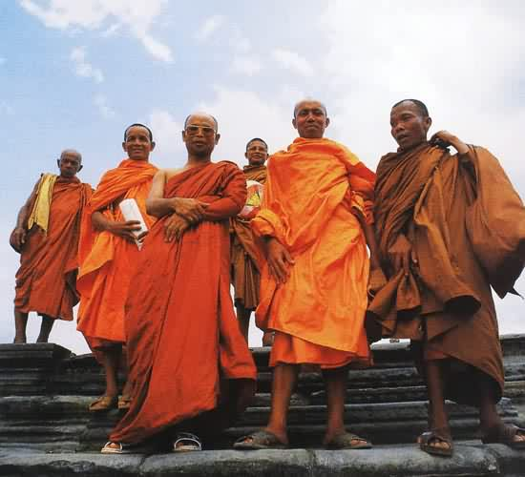
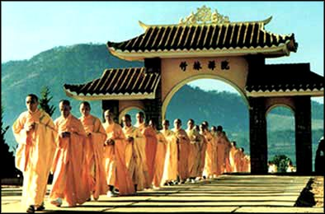
Sections (Sects)
Theravada- more traditional and conservative
Mahayana- built along the Silk Road

Slide 22
Mainly Located Read the map and make an inference
Notes:
Asia/Southeast Asia

Slide 23
Religious Texts
Sutras- words and teachings of Buddha
Tripitaka- teachings of Buddha's students
Monks
Tibetan Book of the Dead- read at funerals which depicts the path from death to rebirth
Notes:
Monks are responsible for preserving and teaching Buddha's word

Slide 24
Organize your thoughts!
Notes:
What is nirvana? Tell students that in addition to writing it down they need to create a picture or symbol that will help that remember each aspect

Slide 25
Textual Evidence
On page _____, it said….
The author wrote….
The graphic showed….
An example is…..
In the text it said….
I know because….

Slide 27
Bellwork (On a piece of paper or in noteability)
Think back: What was the silk road? We will discuss in a little bit.

Slide 28
Cause and Effect- here we go again ☺
It is important to understand the causes and effects of what you are studying
Cause= why the event happened
Effect= describes the consequences of the event
“What caused the event to happen?”
“What happened next?”
Put it into a sentence
______________because ______________.
effect cause

Slide 29
The Spread of Buddhism- Cause and Effect
You have 2 links on Edmodo
Divide your group into 2- half of you read one and half read the other
You will then create your OWN graphic organizer/flow chart for the Spread of Buddhism. Make sure you have labels for the CAUSE and for the EFFECTS.
What would be your EFFECT (you have 1)
What would be the CAUSES (what helped Buddhism spread)?
hint: there are 4-5
Make sure you are reading the article thoroughly ☺
Notes:
silk road
Han Chinese Emperor
Ashoka
Monks (missionaries)
http://www.ushistory.org/civ/8d.asp
http://www.buddha101.com/h_spread.htm

