Slide 1
Ancient Egypt
The 3 Kingdoms
Unit 2
Lesson 2

Slide 2
3 Kingdoms of Ancient Egypt
Old Kingdom 2700 BCE-2200 BCE
Pharaoh was a god and a king. Khufu-trade begins
Middle Kingdom 2200 BCE-1550 BCE
Outside invaders conquered Lower Egypt- Ahmose regains power
New Kingdom 1550 BCE-1055 BCE
Military conquests make Egypt rich. Trade routes are developed by Hapshepsut. Ramses the Great reigns.

Slide 3
The Old Kingdom
“The Age of the Pyramids”

Slide 4
The Old Kingdom
3rd-6th dynasty
you’ll often hear it referred to as this
what is a dynasty again?
500 years
Building projects

Slide 5
The Old Kingdom
Political system develops
Pharaoh’s
absolute power over everything and everyone
Believed Egypt belonged to the gods
Many responsibilities

Slide 6
Question to Ponder…
Why do you think Egyptian Pharaohs built pyramids/large scale building projects?

Slide 7
Khufu
Most famous pharaoh of the Old Kingdom
Many monuments built for him
The Great Pyramid of Giza
44 years to build
Oldest and largest of the 3 pyramids of Giza

Slide 9
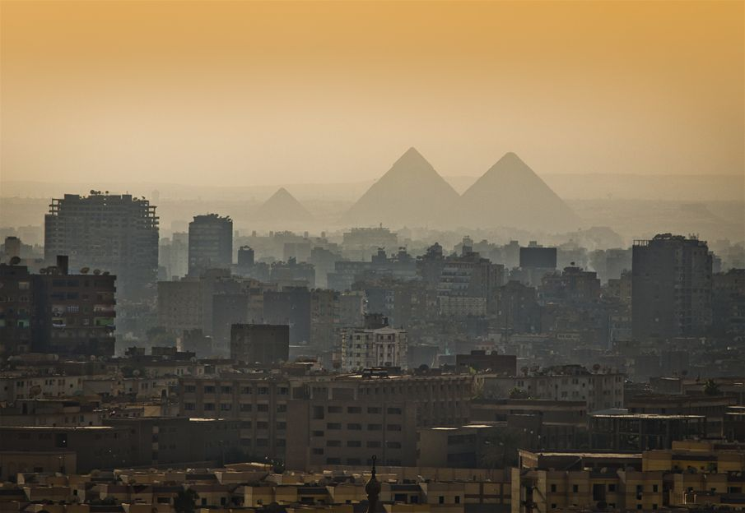

Slide 10
The Great Sphinx of Giza
Lions body and human head
Face of Pharaoh Kahfra
2500 B.C.E
241 feet long/ 66 feet high

Slide 11
Egyptian Society
Notes:
What may be some advantages and disadvantages of such a large segment of the population being farmers, servants, and slaves?
advantages: plenty of food and labor
disadvantages: potential for unrest and rebellion

Slide 12
Trade in the Old Kingdom
2 million people
Traders traveled south along the Nile to Nubia to trade.
Syria to the North East
Notes:
Why is this important?

Slide 13
The Dark Period
Bad leadership
Drought
Nobles challenged Pharaohs power
lower Egypt split away
7th-11th dynasties

Slide 14
Checkpoint
Write down three important pieces of information about the Old Kingdom

Slide 15
The Middle Kingdom
Rise of the Warrior Pharaoh
11th-14th dynasties
Notes:
What do you think that means, warrior pharaoh?

Slide 16
Period of Unrest
Remember..before Middle Kingdom began:
Couldn't’t keep up with the expenses of building large structures
Nobles used their power to challenge pharaohs
Nobles ruled for 160 years
2050 BCE Mentuhotep II defeated the nobles and reunited Egypt
Notes:
Who remembers what that was called

Slide 17
The Middle Kingdom
New Capital- Thebes
Major religious and political center
Valley of the Kings
Reestablished government
Expanded the boundaries
Notes:
At least 15 are buried here

Slide 18
The Peak of the Middle Kingdom
12th dynasty
Powerful army
Economic prosperity
Art
block statues
Writing
entertainment
religious stories

Slide 19
Invasion of the Hyksos
South Asia
Invaded and conquered Lower Egypt for 200 years
had advanced weapons
Pharaoh Ahmose
great war against the Hyksos
Won back the territory
Notes:
13:45-19:20
Also a period where outside forces started to invade Egypt. What reasons do you think they had to start invading?

Slide 20
Checkpoint
Write down three important facts about the Middle Kingdom

Slide 21
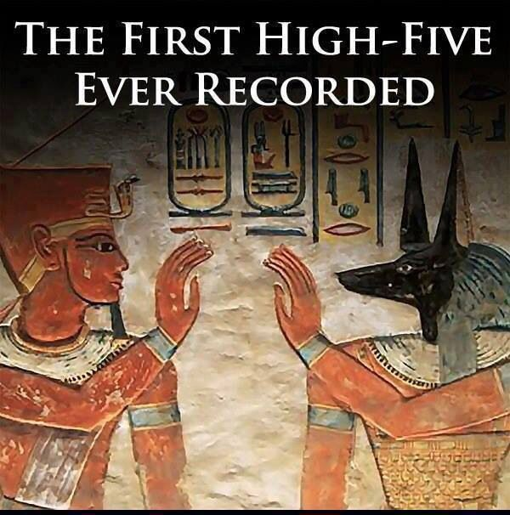
Bellwork
Download “Two New Kingdom Rulers” chart
Answer this question:
Who defeated the Hyksos?

Slide 22
New kingdom
Egypt at the height of its glory!

Slide 23
Building an Empire
Conquest and trade
Feared more invasion
Conquer the Hyksos and the Syrians
Kingdom of Kush in Nubia south of Egypt
1400’s BCE leading military power in the area
Made them rich and powerful

Slide 24
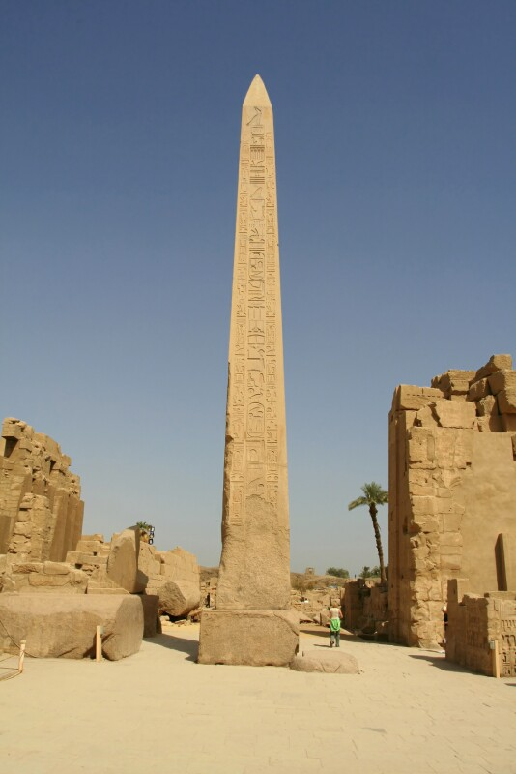
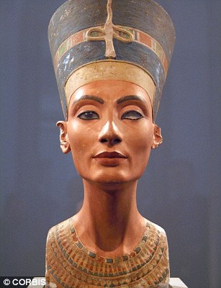
The Effects of Trade
Trade=new lands=new ideas=more $$$
Queen Hatshepsut helped expand trade
Husband died-took over even though people didn’t want her to
more $$ to support the arts and architecture
Obelisks
longest reigning female ruler
most interested in economic growth
Notes:
she was more interested in ensuring economic prosperity and building and restoring monuments throughout Egypt and Nubia than in conquering new lands. Magnificent temple built for her near the city of thebes / first female to rule all of egypt. Wanted to create new building projects. Created a new architecture design called an obelisk -97 feet tall- still stands today. hutmose III began a campaign to eradicate Hatshepsut’s memory: He destroyed or defaced her monuments, erased many of her inscriptions and constructed a wall around her obelisks.

Slide 25
Fall of the Egyptian Empire
What happens when you start becoming really rich and really powerful?
Notes:
Invasions wouldn’t stop

Slide 26
Fall of Egypt
Ramses II is known as one of the greatest Pharaohs in Egyptian history
Read about Ramses II
After Ramses II died, new leaders weren’t able to keep invaders out
Egypt lost its power and fell
Notes:
http://www.ducksters.com/history/ancient_egypt/ramses_ii.php

Slide 27
Checkpoint
Write down three important facts about the New Kingdom

Slide 28
Two New Kingdom Rulers

